Slide 1
Test Design Techniques
Ha Nguyen

Slide 2




Agenda
Equivalent Partitioning
Boundary Value Analytic
Decision Table
State Transition Testing

Slide 3

Black Box Test- Test Techniques
Test techniques for Black Box Test (Specification-Based) can be:
Equivalent Partitioning
Boundary Value
Decision Table/Pairwise testing
State Transition

Slide 4

Equivalent Partitioning
Take each input condition described in the specification and derive at least two equivalence classes for it.
One class that satisfies the condition – the valid class
Second class that doesn't satisfy the condition – the invalid class

Slide 5

A savings account in a bank earns a different rate of interest depending on the balance in the account.
If a balance in the range $0 up to $100 has a 3% interest rate, a balance over $100 and up to $1000 has a 5% interest rate, and balances of $1000 and over have a 7% interest rate, we would initially identify three valid equivalence partitions and one invalid partition
Invalid partition
Valid( For 3% interest)
Valid( For 5%)
Valid( For 7%)
-$0.01
$0.00
$100.00
$100.01
$999.99
$1000.00

Slide 6
Value Boundary Analysis
Smallest number
0
Largest number

Slide 7

Consider a printer that has an input option of
To apply boundary value analysis, we will take the minimum and maximum (boundary) values
from the valid partition (1 and 99 in this case) together with the number of copies to be made,
from 1 to 99
The first or last value respectively in each of the invalid partitions adjacent to the valid partition
(0 and 100 in this case). In this example we would have three equivalence partitioning tests
(one from each of the three partitions) and four boundary value tests

Slide 8

In a system designed to work out the tax to be paid:
An employee has £4000 of salary tax free. The next £1500 is taxed at 10%
The next £28000 is taxed at 22%
Any further amount is taxed at 40%
You: To the nearest whole pound, which of these is a valid Boundary Value Analysis test case?
A. £1500
B. £32001
C. £33501
D. £28000
33501

Slide 9
An event is started at January, 1st to January, 15th.
You: Design test cases by Boundary Values Analysic

Slide 10
Quick question: Why Both EP and BVA?
Every boundary is in some partition, if you did only boundary value analysis you would also have
tested every equivalence partition
If only testing boundaries we would probably not give the users much confidence as we are
using extreme values rather than normal values

Slide 11

Decision Table
Steps to Create a decision table
Analyse requirement and list all Conditions/Inputs
Calculate the number of Possible Combinations (Rules)
Place all of the Combinations into the Table
Reduce test combinations
Decide test cases

Slide 12
If you are a new customer and you want to open a credit card account then there are three conditions first you will get a 15% discount on all your purchases today, second if you are an existing customer and you hold a loyalty card, you get a 10% discount and third if you have a coupon, you can get 20% off today (but it can’t be used with the ‘new customer’ discount). Discount amounts are added, if applicable
You: Create a decision table for this

Slide 13


Step 1: Analyse and list All Stub Conditions (Causes)
Write down the values the cause/condition/input can assume
Conditions | Values
New customer( 15%) | True/False
Loyalty(10%)
Coupon( 20%)
Actions
Discount( %)
Put the most important cause first
Put multiple valued causes last

Slide 14
Step 2: Calculate combinations
Number of Values to the power of the number of causes with these values
If all causes are simply Y/N values: 2^{number of causes}
If 1 cause with 3 values and 3 with 2: 3¹ * 2³ = 24
2³ = 8
Or, use the Values column and
multiply each value down the
column, eg. 3*2*2*2=24

Slide 15
Step 3: Place all of the Combinations into the Table
Determine Repeating Factor (RF): divide remaining combinations by the number of possible
values for that cause/input
Write RF times the first value, then RF times the next etc. until row is full
Next row, go to 1
Conditions | Rule 1 | Rule 2 | Rule 3 | Rule 4 | Rule 5 | Rule 6 | Rule 7 | Rule 8
New customer( 15%) | True | True | True | True | False | False | False | False
Loyalty(10%) | True | True | False | False | True | True | False | False
Coupon( 20%) | True | False | True | False | True | False | True | False
Actions
Discount( %)

Slide 16
Step 4: Reduce combinations
Find indifferent combinations – place a ‘-’
Join columns where columns are identical
Tip: ensure the effects are the same
Conditions | Rule 1 | Rule 2 | Rule 3 | Rule 4 | Rule 5 | Rule 6 | Rule 7 | Rule 8
New customer( 15%) | True | True | True | True | False | False | False | False
Loyalty(10%) | True | True | False | False | True | True | False | False
Coupon( 20%) | True | False | True | False | True | False | True | False
Actions
Discount( %) | x | x | 20 | 15 | 30 | 10 | 20 | 0

Slide 17
Step 5: Create test cases
Write test cases based on the table. At least one test case per column gives full coverage of all business
rules.
Rule 3, 4, 5, 6, 7, 8

Slide 18
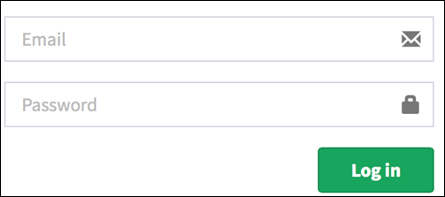
Let's create a decision table for a login screen
The condition is simple if the user provides correct username and password
the user will be redirected to the homepage. If any of the input is wrong,
an error message will be displayed

Slide 19
Stage Transition Testing
A state transition model
A state transition model has four basic parts
The states that the software may occupy (open/closed or funded/insufficient funds);
The transitions from one state to another (not all transitions are allowed);
The events that cause a transition (closing a file or withdrawing money);
The actions that result from a transition (an error message or being given your cash).

Slide 20
Electronic clock
A simple electronic clock has four modes, display time, change time, display date and change date
The change mode button switches between display time and display date
The reset button switches from display time to adjust time or display date to adjust date
The set button returns from adjust time to display time or adjust date to display date

Slide 21
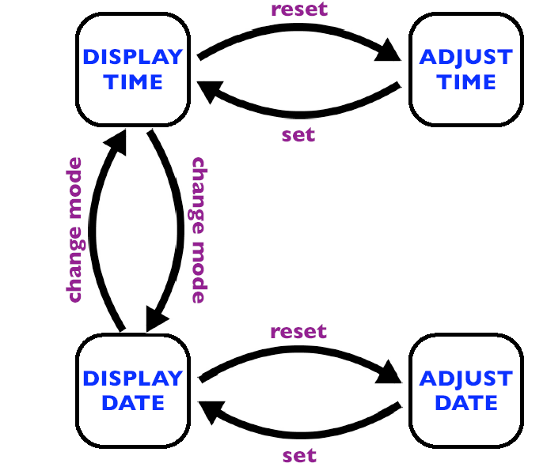

Slide 22
You: Let's create a state transition model
Let's consider an ATM system function where if the user enters the invalid password
three times the account will be locked. In this system, if the user enters a valid
password in any of the first three attempts the user will be logged in successfully.
If the user enters the invalid password in the first or second, try the user will be
asked to re-enter the password. And finally, if the user enters incorrect password
3rd time, the account will be blocked

Slide 23

Thanks for your listening

